Slide 1
A network analysis of
Actors/Directors and Movies
Simrat Benipal, Jose Perales, Ishrat Naba
Group # 11
Netflix II
Notes:
Jose

Slide 2




Nodes, Links
Nodes: People (Cast, Directors) and Movies
Total Number of Nodes = 35,133
Links: Represent the involvement of people in a Movie
Total Number of Links = 49,577
NARCOS
ARCANE
COWBOY BEBOP
LUCIFER
Notes:
Jose

Slide 3
DATASET
Dataset link: Netflix Movies and TV Shows (last updated 2021)
Contains data on all TV Shows and Movies.
NARCOS
ARCANE
COWBOY BEBOP
LUCIFER
Notes:
Jose

Slide 4
DATASET ⇒ NETWORK
Raw Dataset (CSV)
Clean Data (JSON)
GEXF File
GEPHI Network
GEXF (Graph Exchange XML Format), type of XML-based format for storing graphs.
These files are used by GEPHI to render graphs and create adequate visualizations.
Ref: https://www.maplesoft.com/support/help/maple/view.aspx?path=Formats%2FGEXF
Notes:
Jose

Slide 5
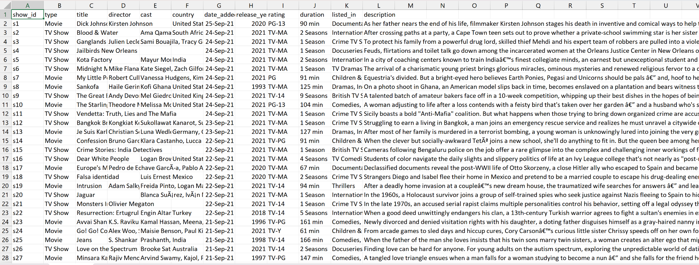
Raw Data (CSV)
Remove TV Shows
Remove irrelevant fields (show_id, country, description)
Separate directors and cast to create individual nodes
Notes:
Simrat
Removed all the TV shows
Removed the description column, show_id, country fields as these were unnecessary for our analysis
We also removed some of the movies with insufficient information, such as missing director or actor fields.

Slide 6
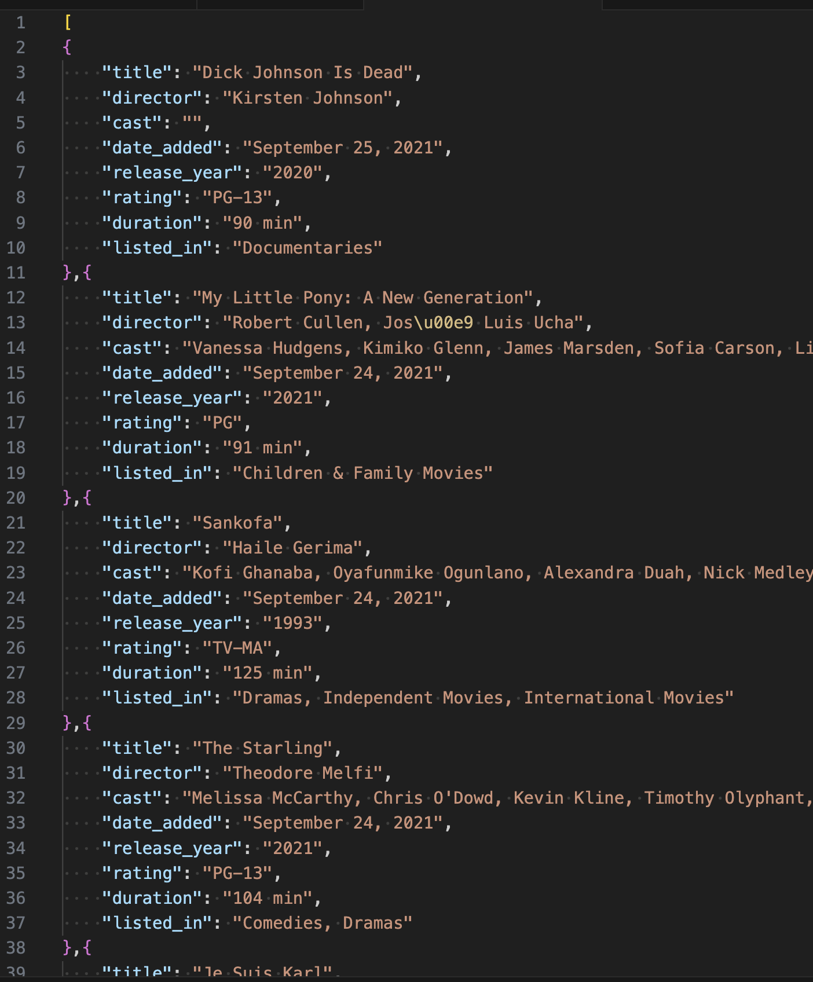
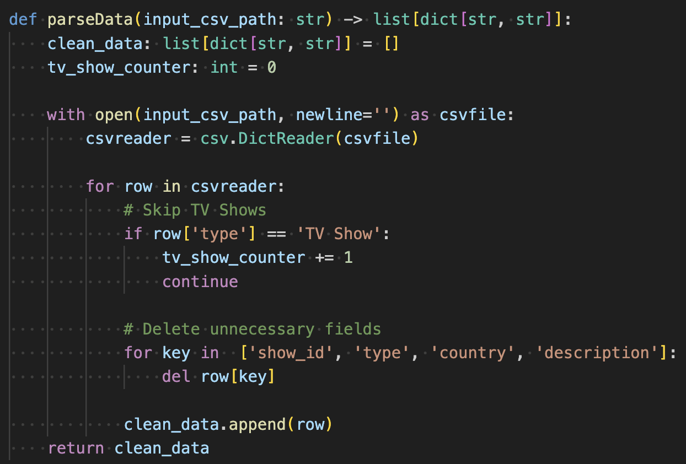
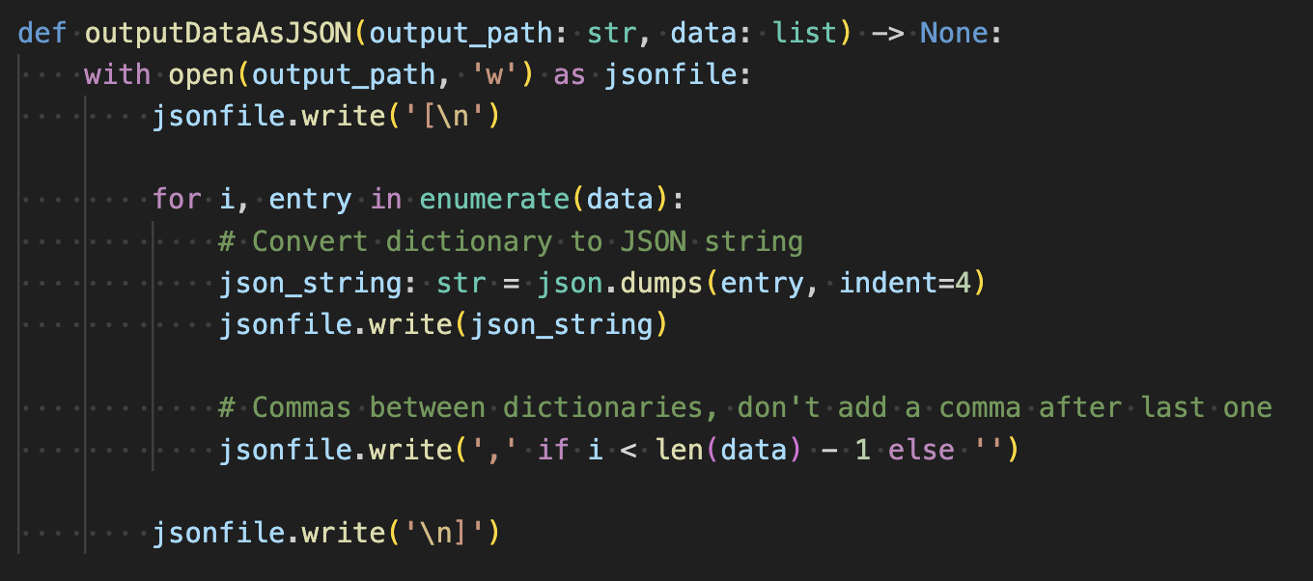
Data Cleaning
Notes:
Jose

Slide 7
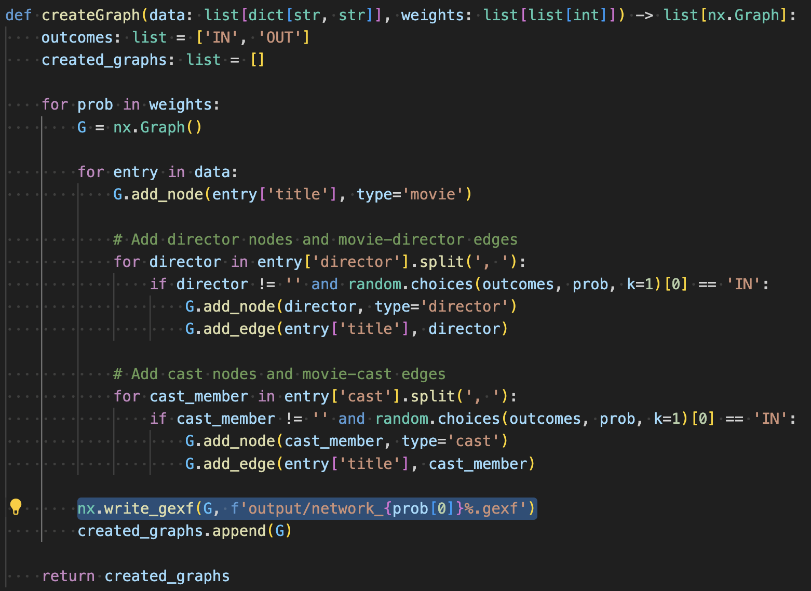
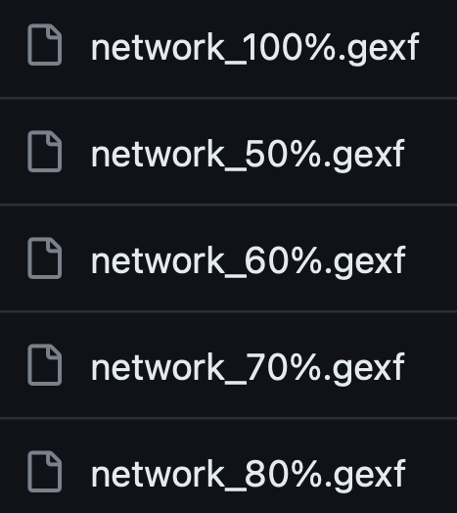
GEXF File Creation
Notes:
Jose

Slide 8
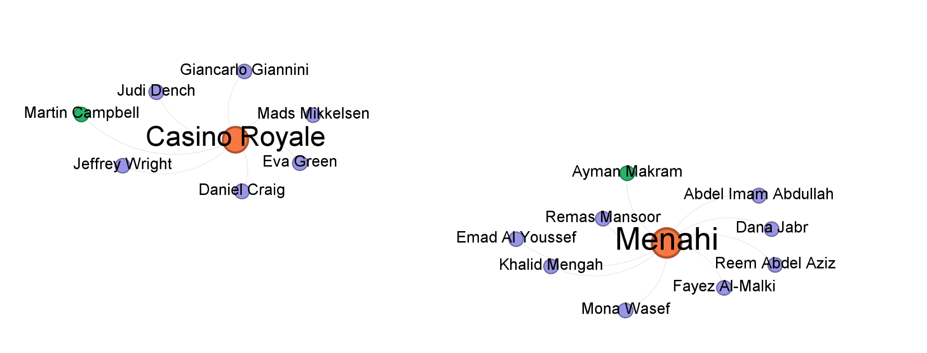
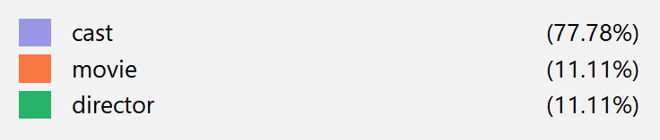
Network Visualizations (GEPHI)
Color is used to differentiate between nodes
Movies →Orange
Actors → Violet
Directors (green)
Size is used to represent the degree of the node.
Higher Degree ⇒ Higher Collaboration ⇒ Bigger Node
Notes:
Simrat
we used color to differentiate between different nodes, movies are represented by orange, actors by violet color and directors with green color
We also used the size of a node to represent its degree, which in our case represent higher collaboration

Slide 9
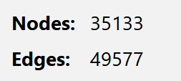
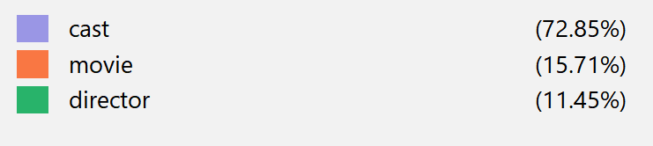
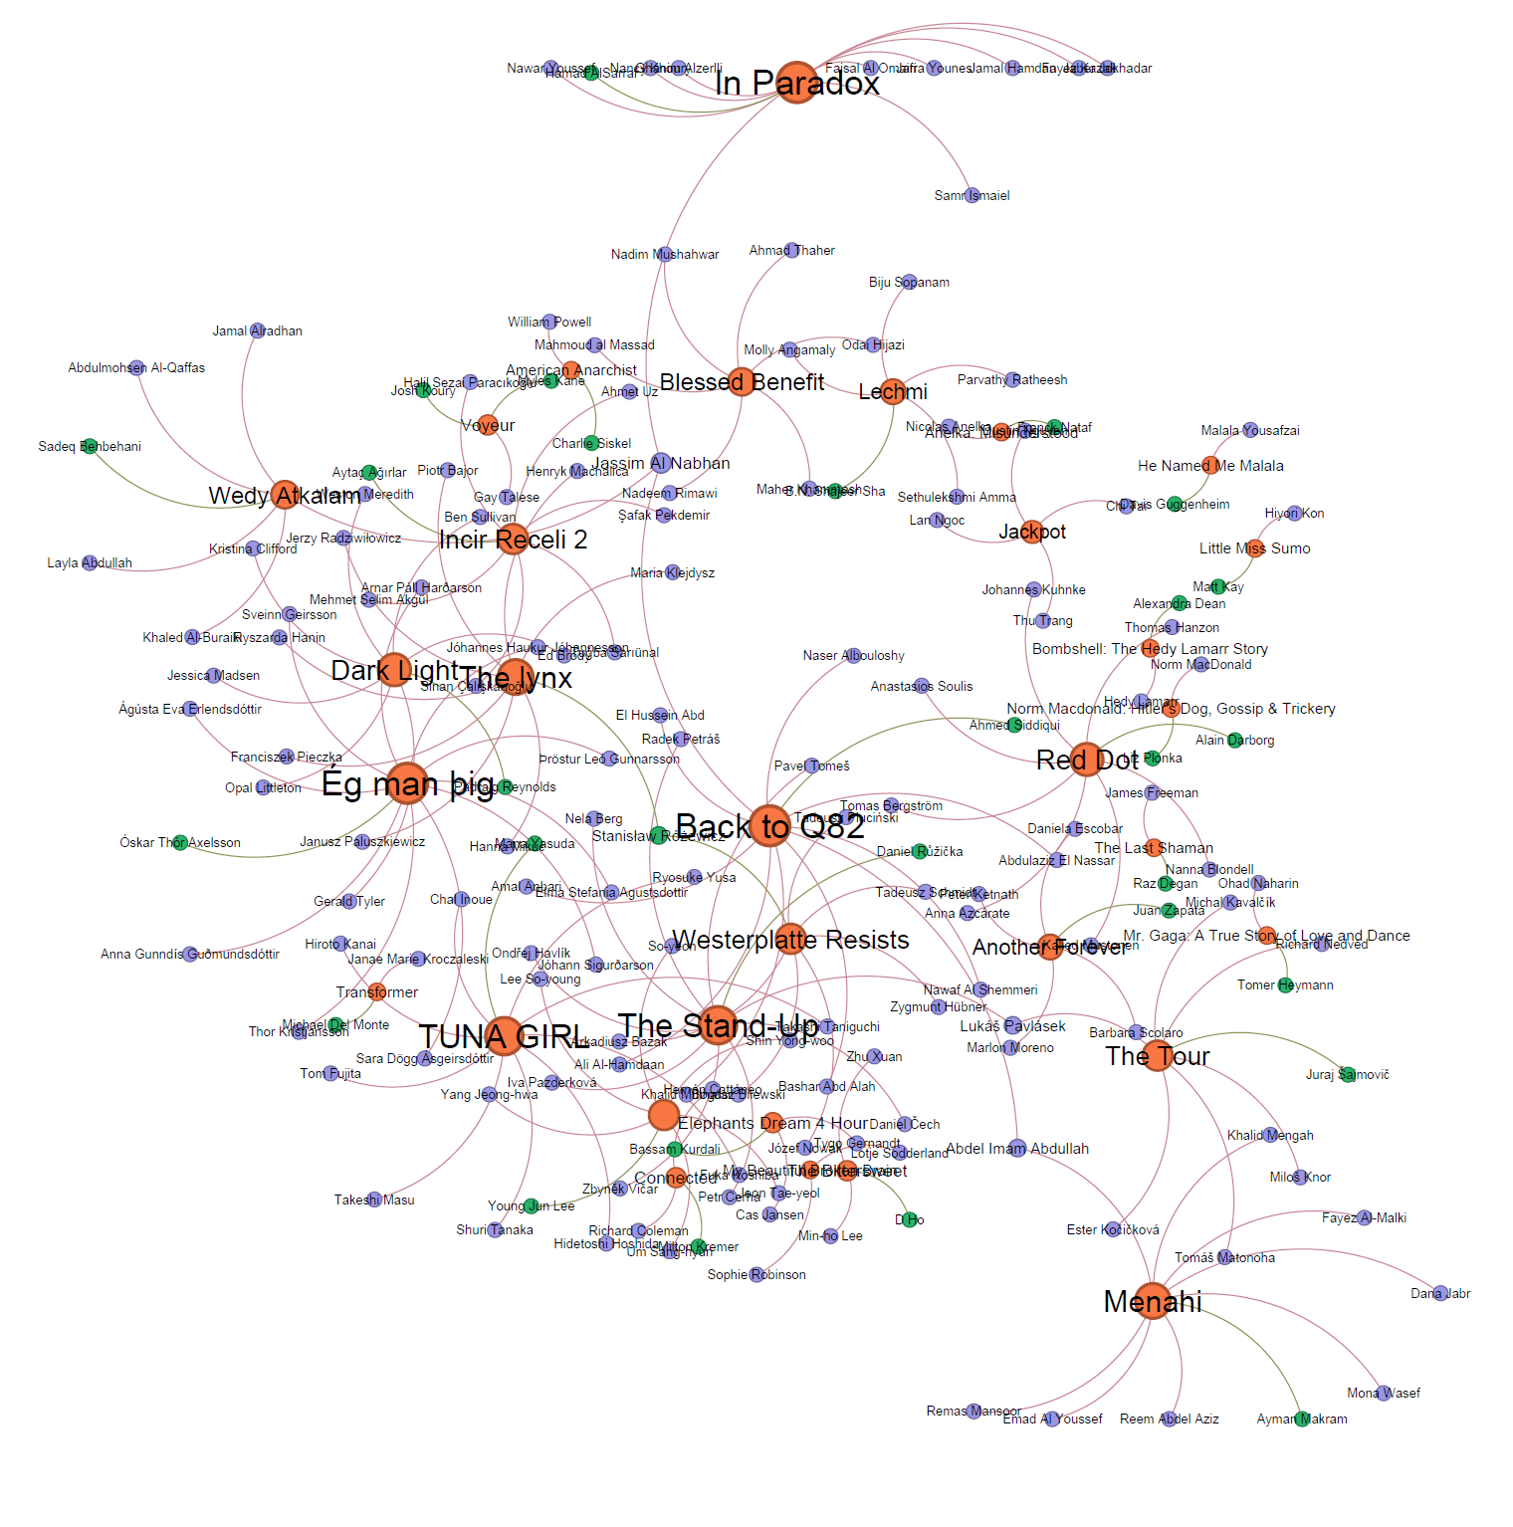
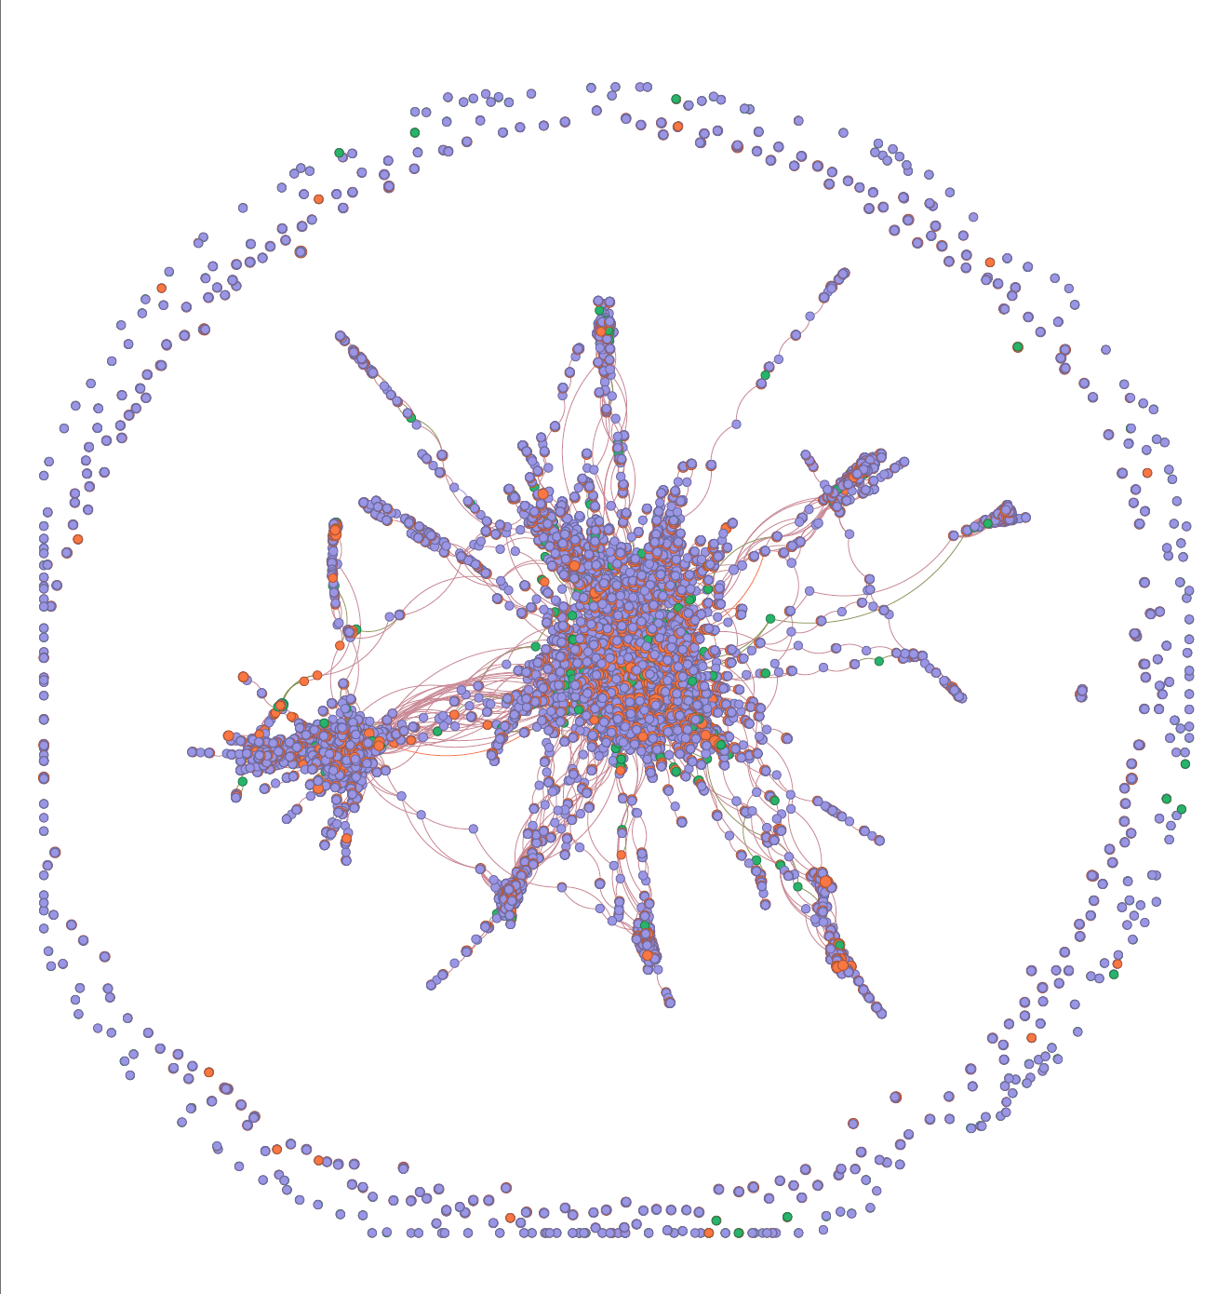
Network Visualizations
Notes:
Simrat
Majority of the nodes are clustered in the center of the graph on the right hand side.
Majority of the movies were either from Hollywood or Bollywood, which gets clustered in the center.
There were certain movies with degree 1, that is these movies had director and cast of the same person, this resulted in a disconnected nodes in the graph
Example: Panoptic

Slide 10
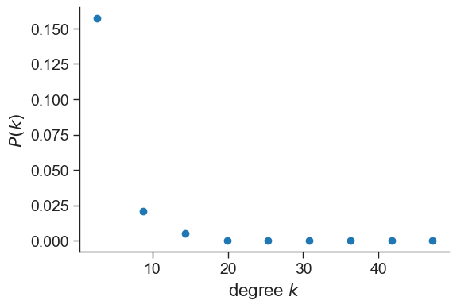
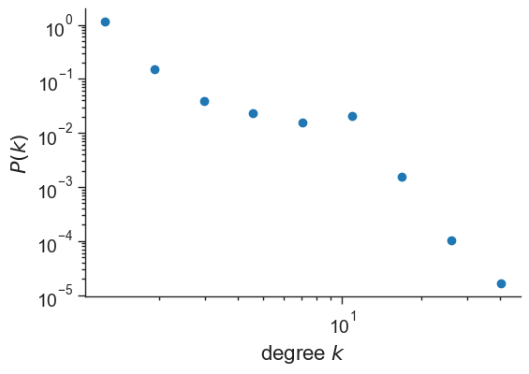
Degree Distribution
Minimum degree --> 1, Maximum degree: 50
Average degree --> 2.82
Nodes with degree less than 10 are very common.
Nodes with higher degree, like 30-50, are rare.
Notes:
Jose

Slide 11
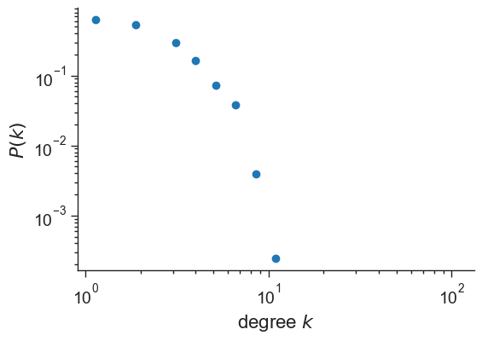
Null Model
Compared to our graph, this null model:
Has less clusters/preferential attachment, likely due to the randomness of the Erdos-renyi model (tendency to have less attachment)
Notes:
Jose

Slide 12






Research Questions
Which TV Ratings, categories, and movie lengths are most prevalent in Netflix?
Is there a correlation between the duration of a movie, its TV Rating, and its release year?
Does Netflix have a preference for newer movies as compared to older ones?
Number of Movies per category (i.e. drama, action)?
Are there key people acting as a bridge between different clusters of actors/directors?
Do some directors have a preference for longer movies or for a certain TV Rating?
Notes:
Ishrat

Slide 13
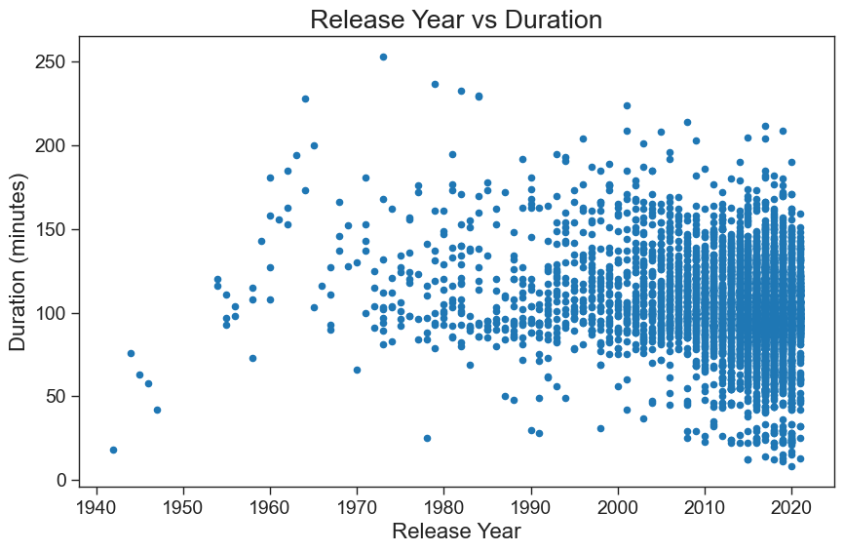
Notes:
Mention that we have started analyzing the network and this graph is an example of us trying to establish if there is any correlation between the duration of a movie and its release year - ISHRAT

Slide 15



REFERENCES
Dataset::https://www.kaggle.com/datasets/shivamb/netflix-shows/data

